Slide 1
Screen -Video Recording

Slide 2
TABLE OF CONTENTS
01
Basic Concepts -Steps
02
How to we use

Slide 3
STEPS
Plan
Record
Save or
Render
Edit
Render

Slide 4
PLAN-SCENARIO
01
02
03
04
OUR PURPOSE Why do we need to screen recording?
WHAT DO WE HAVE? Our hardware , limitations.
WHAT DO WE NEED? Suitable Softwares
WHERE DO WE USE? For fun, youtube channel, etc.

Slide 5
PURPOSE
Teaching
Sound, quality,time limitation,
Record video,film
Time, automatic record
Game
Streaming Video
For fun,family
Effects

Slide 6
WHAT DO WE HAVE?
Our hardware , limitations
Operating System
Your Computer?
Windows 10, 8,7
MacOS
64 Bit
32 Bit
Linux

Slide 7
SUITABLE SOFTWARE
 |  | 32 bit | 64 Bit | Window 7 ,8,10 | MAC | Linux
CAMTASIA | Screen Recorder + Editing 30 Free Trial | Cam.Studio 8
ScreenCast-O-Matic | Online Screen Recorder – Editing 30 days Free Trial
FlaskBack Pro | 10 days Free Trial
Mowavi
İce-Cream Screen Recorder
BandiCam

Slide 8
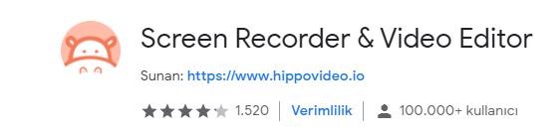
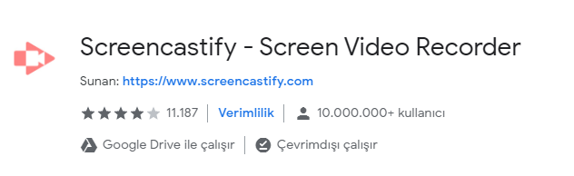
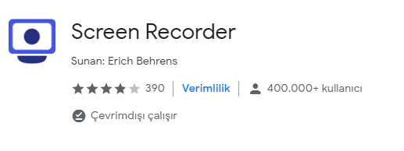
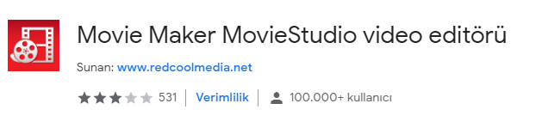
Chrome

Slide 9
FOR SPEECH
Text To Speech
2006-2010
Online
https://spik.ai/generate/rwtnn0nvph/ http://www.fromtexttospeech.com/ https://www.naturalreaders.com/online/

Slide 10
THANKS!

